Slide 1

Technology in Action
15th Edition
Chapter 12
Behind the Scenes: Networking and Security in the Business World
Notes:
If this PowerPoint presentation contains mathematical equations, you may need to check that your computer has the following installed:
1) MathType Plugin
2) Math Player (free versions available)
3) NVDA Reader (free versions available)

Slide 2
Learning Objectives (1 of 3)
12.1 List the advantages for businesses of installing a network.
12.2 Explain the differences between a client/server network and a peer-to-peer network.
12.3 Describe the common types of client/server networks as well as other networks businesses use.
12.4 List the common types of servers found on client/server networks.
12.5 Describe the common types of network topologies and the advantages and disadvantages of each one.
Notes:
Slide 2 is a partial list of textbook Learning Objectives numbers and statements.

Slide 3
Learning Objectives (2 of 3)
12.6 Describe the types of wired and wireless transmission media used in networks.
12.7 Describe how network adapters help data move around a network.
12.8 Define MAC addresses, and explain how they are used to move data around a network.
12.9 List the various network navigation devices, and explain how they help route data through networks.
Notes:
Slide 3 is the continuing list of textbook Learning Objectives numbers and statements.

Slide 4
Learning Objectives (3 of 3)
12.10 Explain why network operating systems are necessary for networks to function.
12.11 List major security threats to networks, and explain how network administrators mitigate these threats.
Notes:
Slide 4 is the final list of textbook Learning Objectives numbers and statements.

Slide 5
Client/Server Network Basics
A network is a group of two or more computing devices (nodes)
Configured to share information and resources
Printers, files, and databases
Businesses gain advantages from deploying networks
Notes:
Recall that a network is a group of two or more computing devices— or nodes—that are configured to share information and resources such as printers, files, and databases.
Businesses such as your school or an insurance company gain advantages from deploying networks, similar to the advantages gained with a home network.

Slide 6
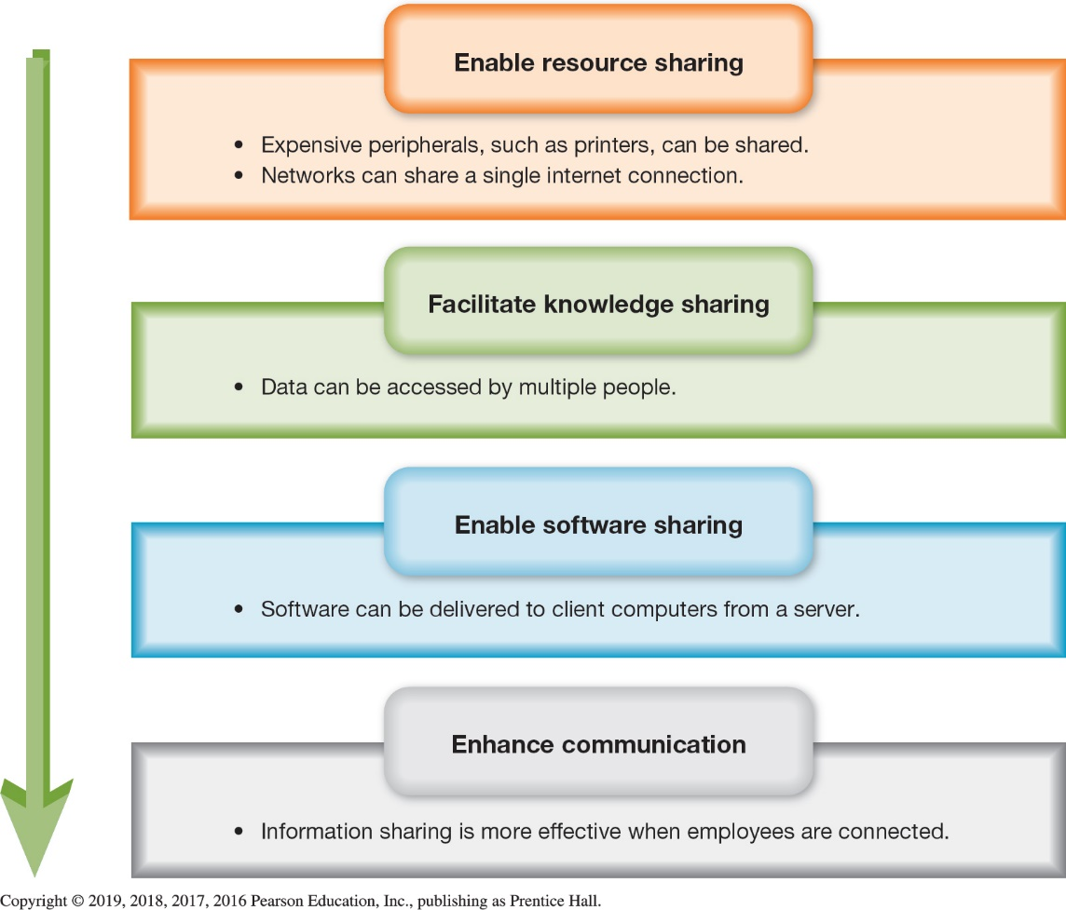
Client/Server Network Basics Networking Advantages (1 of 2) (Objective 12.1)
Advantages
Enable sharing of:
Resources
Knowledge
Software
Enhance communication
Notes:
Networked computers have many advantages over individual computers:
Networks enable people to share peripherals such as printers or share resources.
Networked databases can serve the needs of many people at one time and can increase the availability of data.
Installing a new version of software on everyone’s desktop in a business with many employees can be time-consuming.
Social networking tools, e-mail, and instant messaging are powerful applications when deployed on a network.

Slide 7
Client/Server Network Basics Networking Advantages (2 of 2) (Objective 12.1)
Disadvantages
Additional personnel
Requires special equipment and software
Notes:
The disadvantages of a network are:
Additional personnel are often required.
Networks require special equipment and software.

Slide 8
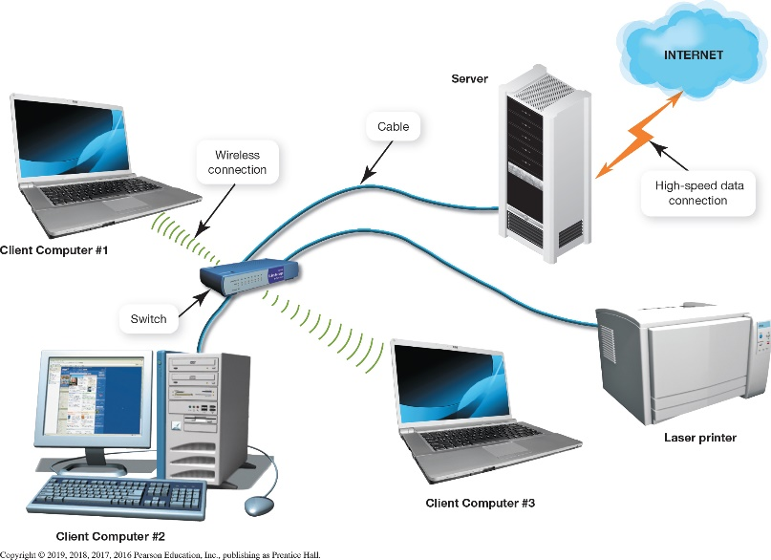
Client/Server Network Basics Comparing Client/Server and Peer-to-Peer Networks (Objective 12.2)
Client/Server network
Centralized
Peer-to-peer (P2P)
Decentralized
Advantages of client/server networks
Efficient data flow
Scalability – more users can be added without affecting the performance of the network
Notes:
The majority of computer networks are based on the client/server model of computing.
Client/server networks are said to be centralized.
The smallest networks, such as peer-to-peer (P2P) networks, are typically used in homes and small businesses.
Peer-to-peer networks are decentralized.
There are at least two main advantages to a client/server network.
The main advantage of a client/server relationship is that it makes data flow more efficiently than in P2P networks.
Client/server networks also have increased scalability, which means that more users can be added easily without affecting the performance of the other network nodes.

Slide 9
Client/Server Network Basics Types of Client/Server Networks (1 of 2) (Objective 12.3)
Local Area Network (LAN)
Few users over small geographic area
Wide Area Network (WAN)
Many users over wide physical area
Intranet–private network set up by a business
Extranet–area of an intranet only used by certain people on the intranet
Electronic data interchange (EDI)
Notes:
A LAN is a small group of computers linked over a small geographic area.
A WAN comprises large numbers of users over a wider physical area.
An intranet is a private network set up by a business or an organization.
An area of an intranet that only certain corporations or individuals can access is an extranet.
Electronic data interchange (EDI) allows the exchange of large amounts of business data.

Slide 10
Client/Server Network Basics Types of Client/Server Networks (2 of 2) (Objective 12.3)
Virtual private networks (VPN) use the public Internet to build a secure, private network
Tunneling
Key components of a client/server network
Servers
Network topologies
Transmission media
Network adapters
Network navigation devices
A network operating system
Notes:
A virtual private network (VPN) uses the public Internet communications infrastructure to build a secure, private network among various locations.
The main technology for achieving a VPN is called tunneling.
The key components of a client/server network are as follows:
Servers.
Network topologies (the layout of the components).
Transmission media.
Network adapters.
Network navigation devices.
A network operating system.

Slide 11
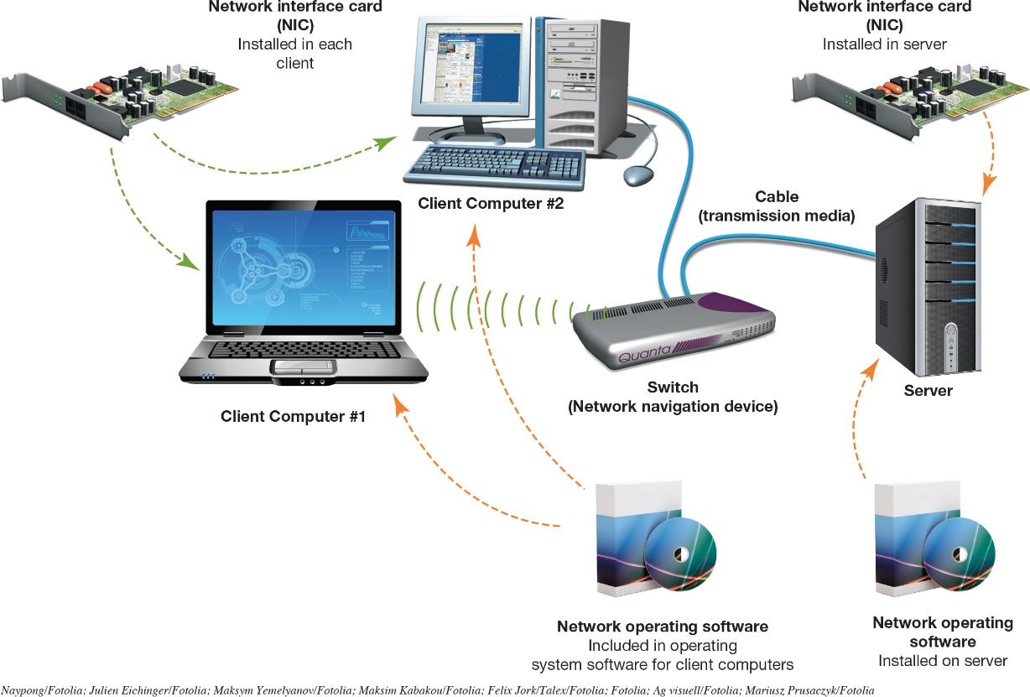
Servers and Network Topologies Servers (Objectives 12.4)
Dedicated server used to fulfill a specific function
Common types
Authentication
File
Print
Application
Database
E-mail
Communications
Web and Cloud
Notes:
The number and types of servers on a client/server network depend on the network’s size and workload. Small networks would have just one server to handle all server functions.
Any task that’s repetitive or demands a lot of time from a computer’s processor is a good candidate for a dedicated server. Common types are:
Authentication servers.
File servers.
Print servers.
Application servers.
Database servers.
E-mail servers.
Communications servers.
Web servers.
Cloud servers.

Slide 12
Servers and Network Topologies Network Topologies (1 of 8) (Objective 12.5)
Bus topology: computers connected in sequence on a single cable
Data collisions: data from two computers collide in the connection media
Packets: data is broken into small segments
Passive technology: nodes do nothing to move data
Terminators absorb signal
Advantages
Simple
Low cost
Notes:
In a bus—or linear bus—topology, all computers are connected in sequence on a single cable.
Data collisions occur when data from two computers collide in the connection media.
Data is broken into small segments, called packets.
Since the nodes do nothing to move data this is considered passive technology.
Terminators absorb signal and do not reflect them back to the network.
The advantages of the bus topology include the simplicity and low cost of the network.

Slide 13
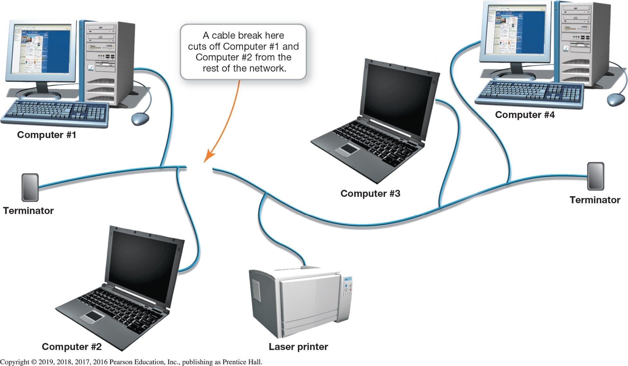
Servers and Network Topologies Network Topologies (2 of 8) (Objective 12.5)
Notes:
Figure 12.8 illustrates a linear bus topology in which all computers are connected in a sequence.

Slide 14
Servers and Network Topologies Network Topologies (3 of 8) (Objective 12.5)
Ring topology: resembles a circle
Token: a special data packet
Passed from computer to computer
Active topology: the nodes participate in the transmission of the data
Advantages
Provides a fairer allocation of resources
Performance remains acceptable
Disadvantages
One computer failure can bring network down
Notes:
The computers and peripherals in a ring—or loop—topology are laid out in a configuration resembling a circle. Data flows around the circle from device to device in one direction only. Because data is passed using a special data packet called a token, this type of topology was once commonly called a token-ring topology.
A ring topology provides a fair allocation of resources.

Slide 15
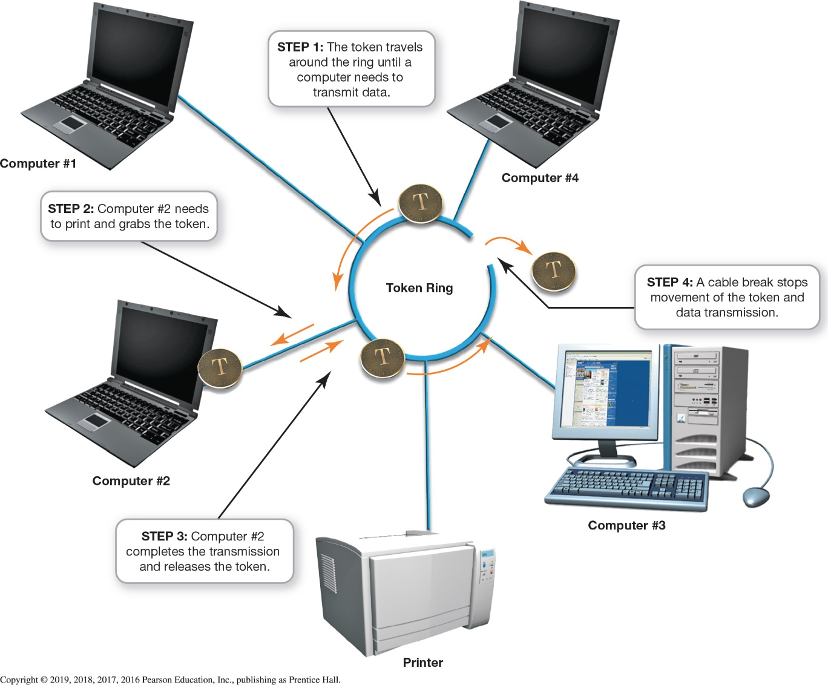
Servers and Network Topologies Network Topologies (4 of 8) (Objective 12.5)
Notes:
Figure 12.9 illustrates how a ring topology provides a fair allocation of resources.

Slide 16
Servers and Network Topologies Network Topologies (5 of 8) (Objective 12.5)
Star topology: nodes connect to a central communications device in a star-shaped pattern
Most widely deployed client/server topology
Offers the most flexibility for a low price
Uses carrier sense multiple access with collision detection (CSMA/CD)
Jam signal aids in addressing data collisions
Notes:
A star topology is the most widely deployed client/server network topology because it offers the most flexibility. In a star topology, the nodes connect to a central communications device called a switch in a pattern resembling a star. It uses carrier sense multiple access with collision detection (CSMA/CD). A jam signal aids in addressing data collisions.

Slide 17
Servers and Network Topologies Network Topologies (6 of 8) (Objective 12.5)
Advantages
Failure of one computer doesn’t affect rest of the network
Easy to add nodes
Performance remains acceptable with growth
Troubleshooting and repairs are easier
Disadvantage
Used to be cost – not as relevant now
Notes:
The advantages of star networks include:
The failure of one computer doesn’t affect rest of the network.
It is easy to add nodes.
Performance remains acceptable with growth.
Troubleshooting and repairs are easier.
The disadvantage of star networks used to be cost, but that is not as relevant now.

Slide 18
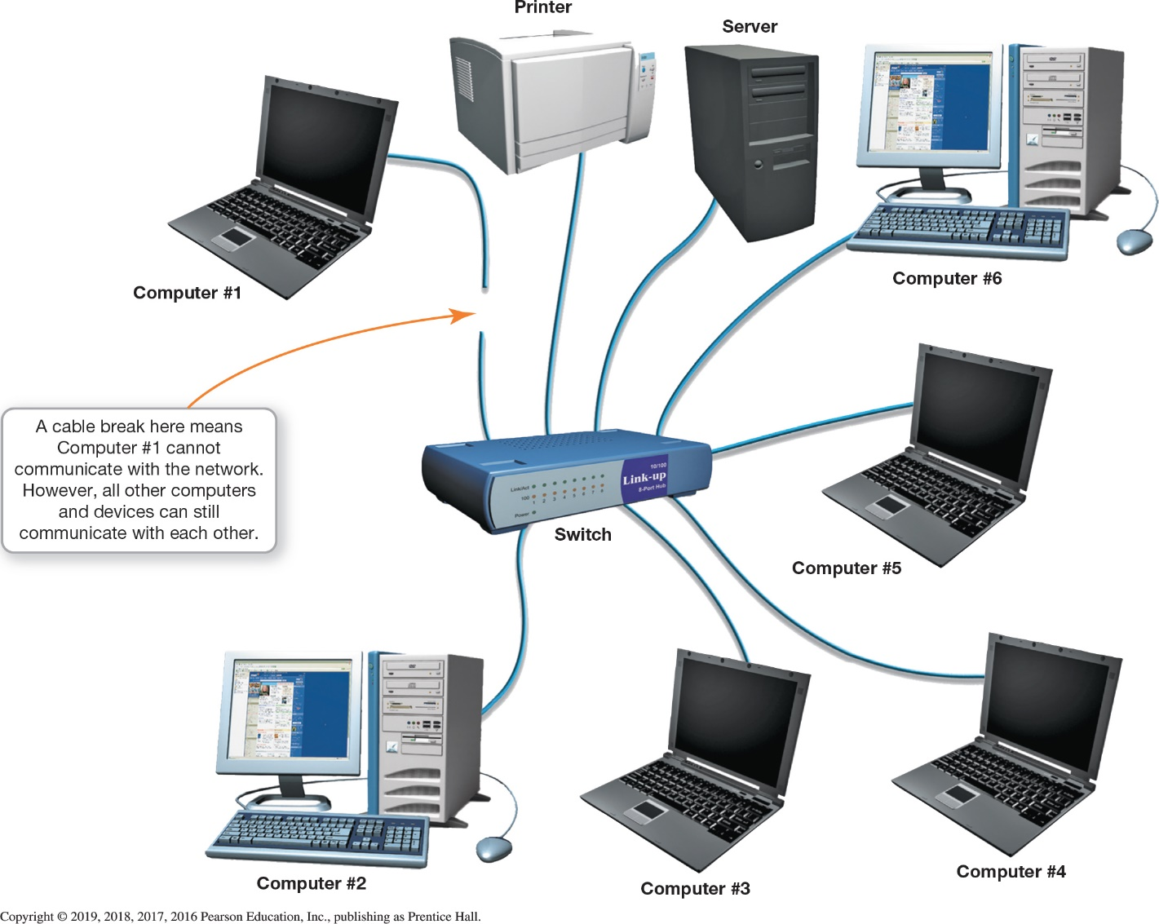
Servers and Network Topologies Network Topologies (7 of 8) (Objective 12.5)
Notes:
Figure 12.10 illustrates a star topology, in which network nodes are connected through a central switch.

Slide 19
Transmission Media Wired and Wireless Transmission Media (1 of 6) (Objective 12.6)
Transmission media through which data flows
Wired
Wireless
Corporate networks use both
Notes:
Transmission media, whether for wired or wireless communications technology, make up the physical system that data takes to flow between devices on the network.
Most corporate networks contain a combination of wired and wireless media.

Slide 20
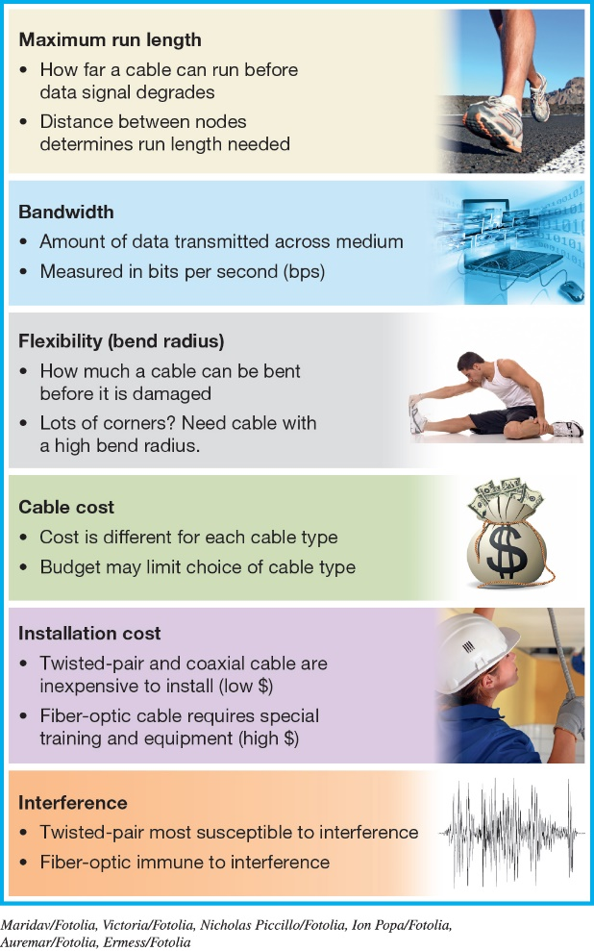
Transmission Media Wired and Wireless Transmission Media (2 of 6) (Objective 12.6)
Factors when choosing cable type
Maximum run length
Bandwidth
Bend radius (flexibility)
Cable cost
Installation cost
Interference
Sources of interference
Electromagnetic interference
Radio frequency interference
Notes:
Although each cable type is different, the same six factors always need to be considered when choosing a cable type: maximum run length, bandwidth, bend radius (flexibility), cable cost, installation cost, and interference.
Sources of interference include electromagnetic interference and radio frequency interference.

Slide 21
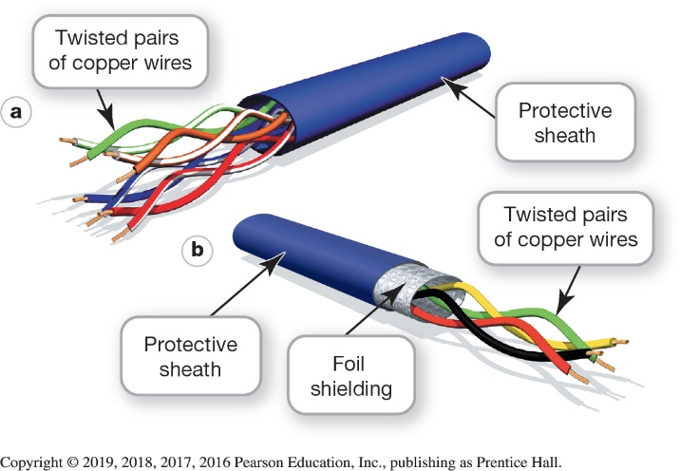
Transmission Media Wired and Wireless Transmission Media (3 of 6) (Objective 12.6)
Twisted-pair cable
Pairs of copper wires twisted around each other
Reduces interference
Reduces crosstalk
Covered by protective sheath
Unshielded has no foil shielding
Shielded has foil shielding
Notes:
Twisted-pair cable consists of pairs of copper wires twisted around each other and covered by a protective sheath (jacket). The twists are important because they cause the magnetic fields that form around the wires to intermingle, making them less susceptible to outside interference.
If the twisted-pair cable contains a layer of foil shielding to reduce interference, it’s called shielded twisted-pair (STP) cable.

Slide 22
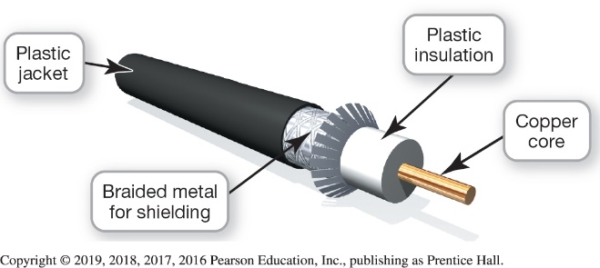
Transmission Media Wired and Wireless Transmission Media (4 of 6) (Objective 12.6)
Coaxial cable
Not as popular, but still used when there is heavy electrical interference
Four components
Core is used for transmitting the signal
Solid layer of nonconductive insulating material
Layer of braided metal shielding
External jacket of lightweight plastic
Notes:
Not as popular as it once was, coaxial cable is still used in manufacturing facilities with heavy electrical interference.
Coaxial cable has four components:
A core is in the very center and is used for transmitting the signal.
A solid layer of nonconductive insulating material surrounds the core.
A layer of braided metal shielding covers the insulation to reduce interference.
An external jacket of lightweight plastic covers the internal cable components.

Slide 23
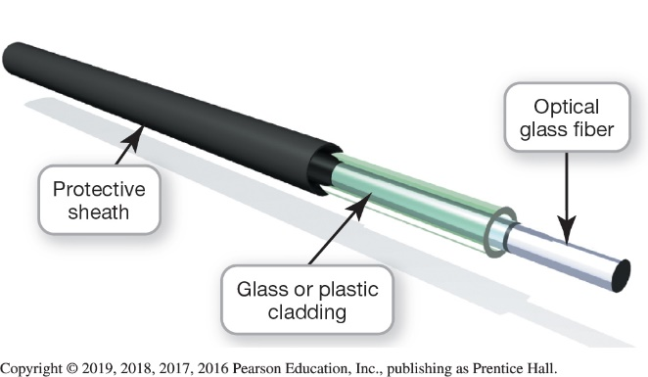
Transmission Media Wired and Wireless Transmission Media (5 of 6) (Objective 12.6)
Fiber-Optic cable
Composed of
Glass (or plastic) fiber through which the data is transmitted
Protective layer of glass or plastic to protect it
Outer jacket (sheath) for additional protection
Transmission is only in one direction
Notes:
Fiber-optic cable is composed of the following:
A glass (or plastic) fiber through which the data is transmitted.
A protective layer of glass or plastic cladding wrapped around the core to protect it.
An outer jacket, which is made of a durable material.
Data transmissions can pass through fiber-optic cable in only one direction. Therefore, at least two fibers (or cores) are contained in most fiber-optic cables to enable transmission of data in both directions.

Slide 24
Transmission Media Wired and Wireless Transmission Media (6 of 6) (Objective 12.6)
Wireless
Very similar to home networks
Wireless access points installed to provide additional coverage
Most businesses use a combination of wired and wireless media
Notes:
Wireless networks in business are very similar to what is available to home networks.
Wireless access points are installed to provide additional coverage.
Most businesses use a combination of wired and wireless media.

Slide 25
Network Adapters and Navigation Devices Network Adapters (Objective 12.7)
Network adapters–Three critical functions:
Generate high-power signals for network transmissions
Break data into packets
Act as gatekeepers for information flowing to and from client computer
Notes:
Network adapters perform three critical functions:
They generate high-powered signals to enable network transmissions.
They’re responsible for breaking the data into packets and transmitting and receiving data. They also are responsible for receiving incoming data packets and, in accordance with networking protocols, reconstructing them.
They act as gatekeepers for information flowing to and from the client computer.

Slide 26
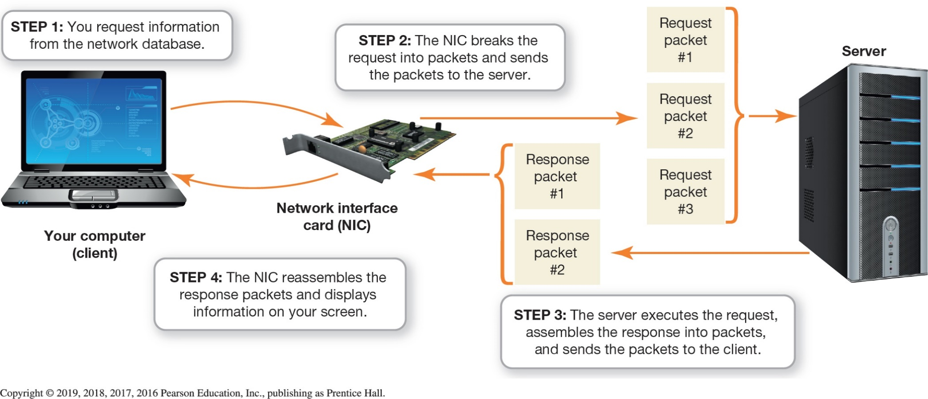
Network Adapters and Navigation Devices Network Adapters (Objective 12.7)
Notes:
Shown In Figure 12.18 is that a network interface card (NIC) is responsible for breaking down data into packets, preparing packets for transmission, receiving incoming data packets, and reconstructing them.

Slide 27
Network Adapters and Navigation Devices MAC Addresses (Objective 12.8)
Media access control (MAC) address
6 two-position characters
First three sets specify the manufacturer
Second set makes up a unique address
Institute of Electrical and Electronics Engineers (IEEE) responsible for allocating blocks of numbers
Not the same as IP address
Notes:
Media access control (MAC) address is 6 two-position sets of characters.
The first three sets specify the manufacturer of the network device.
The second set makes up a unique address of that device.
The Institute of Electrical and Electronics Engineers (IEEE) is responsible for allocating blocks of numbers.
The MAC address is not the same as IP address.

Slide 28
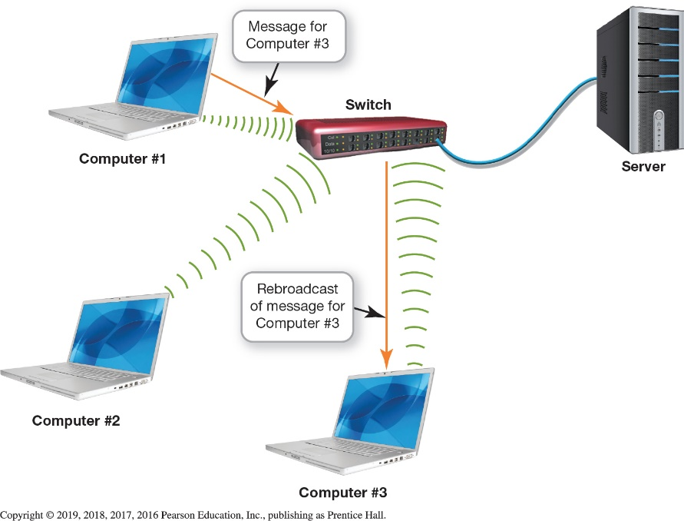
Network Adapters and Navigation Devices Switches, Bridges, and Routers (Objective 12.9)
Switch rebroadcasts data to appropriate network node
Bridge sends data between different collision domains
Router sends information between two networks
Notes:
A switch makes decisions, based on the MAC address of the data, as to where the data is to be sent and rebroadcasts it to the appropriate network node.
A bridge is a device that’s used to send data between different collision domains, depending on where the recipient device is located.
A router is designed to send information between two networks.

Slide 29
Network Operating Systems and Network Security Network Operating Systems (Objective 12.10)
Needs to be installed on each client and server computer
Designed to facilitate communication
Peer-to-peer software built into Windows
TCP/IP is the standard networking protocol
Notes:
Special software known as a network operating system (NOS) needs to be installed on each client computer and server that’s connected to the network to provide the services necessary for them to communicate.
NOS software is designed to facilitate communication between the software and hardware components of your computer.
The software that P2P networks require is built into the Windows, Linux, and Macintosh operating systems.
Most corporate networks use TCP/IP as their standard networking protocol regardless of the manufacturer of their NOS.

Slide 30
Network Operating Systems and Network Security Client/Server Network Security (1 of 4) (Objective 12.11)
Sources of security threats include:
Human errors and mistakes
Malicious human activity
Natural events and disasters
Authentication is used to screen users
Possessed object
Brute force attack
Notes:
Threats to client/server networks can be classified into three main groups:
Human errors and mistakes.
Malicious human activity.
Natural events and disasters.
Authentication is the process whereby users prove they have authorization to use a computer network.
A possessed object is any object that users carry to identify themselves.
Attempting to access an account by repeatedly trying different passwords is known as a brute force attack.

Slide 31
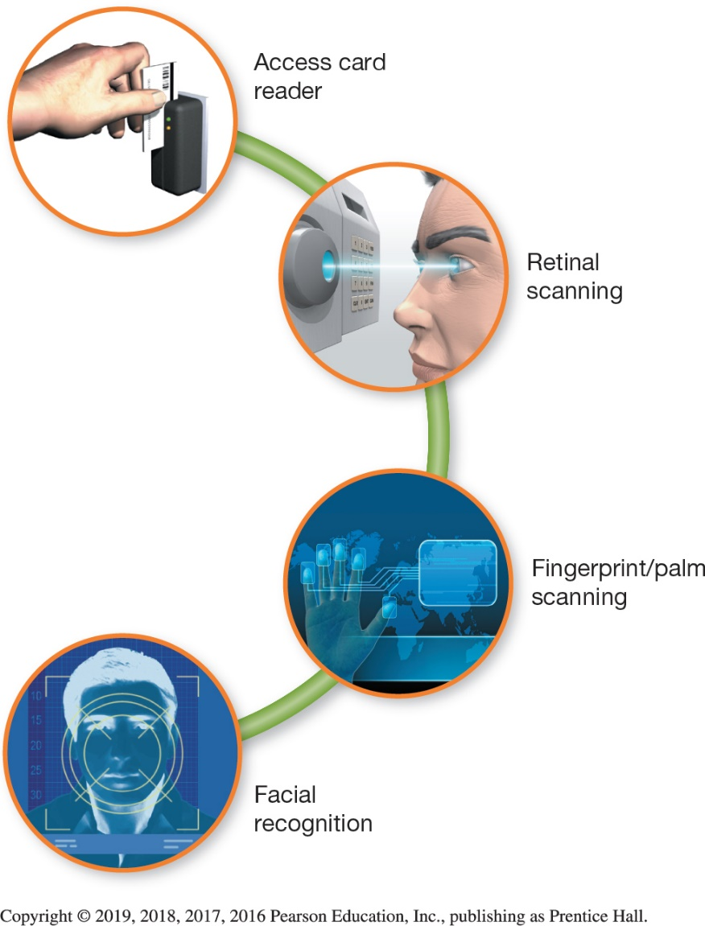
Network Operating Systems and Network Security Client/Server Network Security (2 of 4) (Objective 12.11)
Access privileges restrict access to network assets
Physical protection measures
Access card reader
Biometric authentication device
Notes:
When an account is set up on a network, certain access privileges are granted to indicate which systems the user is allowed to use.
Access card readers provide a relatively inexpensive solution to security for areas needing low-level security.
Biometric authentication devices, such as fingerprint/palm, retinal, and facial-recognition scanners, are used to protect high-security areas such as a server room.

Slide 32
Network Operating Systems and Network Security Client/Server Network Security (3 of 4) (Objective 12.11)
Firewalls can be composed of software or hardware
Packet screening is having an external screening router examine incoming data packets
Bastion host is a heavily secured server located on a special perimeter network
Honey pot is a computer set up to attract unauthorized users
Proxy server acts as a go-between
Notes:
Firewalls can be composed of software or hardware.
Packet screening involves having an external screening router examining incoming data packets.
A bastion host is a heavily secured server located on a special perimeter network.
A honey pot is a computer set up to attract unauthorized users.
A proxy server acts as a go-between.

Slide 33
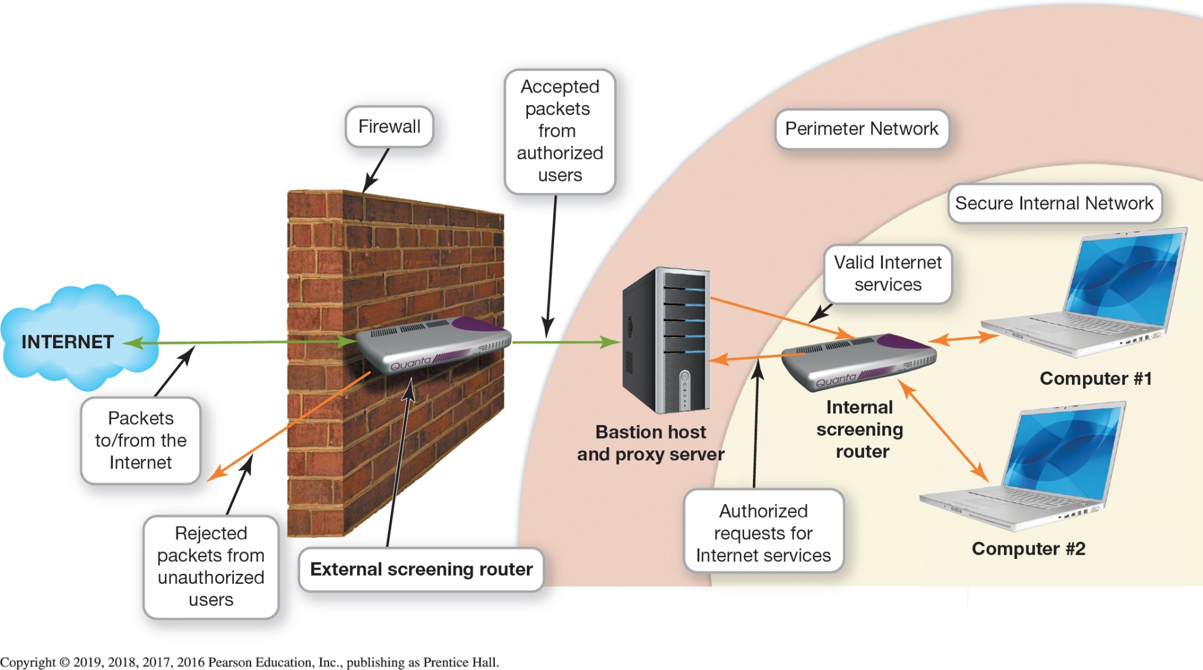
Network Operating Systems and Network Security Client/Server Network Security (4 of 4) (Objective 12.11)
Notes:
Figure 12.24 illustrates how business firewalls provide sophisticated protection from hackers.

Slide 34
Questions
?

Slide 35
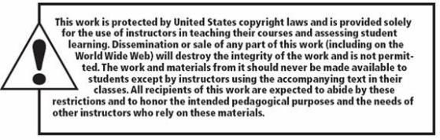
Copyright
All rights reserved. No part of this publication may be reproduced, stored in a retrieval system, or transmitted, in any form or by any means, electronic, mechanical, photocopying, recording, or otherwise, without the prior written permission of the publisher. Printed in the United States of America.

